Slide 1
TCO Analysis

Slide 2
Scenarios Considered
Scenario 1 – UPS Backup + 30 300KW racks + CBU(MSFT)
Scenario 2 – BBU Backup + 30 300KW rack + High energy PSU
Scenario 3 – LTO BBU Backup + 30 300KW racks + ATS PSU
Design Conditions for all Scenarios:
  Data Center Load = 9 MW
  AI POD = 3 MW
  Rack Density = 300 kW per Rack
  2N power redundancy, N+1 cooling redundancy
  Battery backup time: 30 mins
  BBU backup time: 90 secs

Slide 3
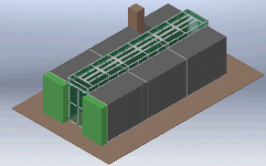
Total Cost Analysis:
Example: Deploy a 3MW AI pod for CSP Customers
DATA CENTER CONFIGURATION
9 MW IT capacity
1 IT rooms
3 pods per room
3 MW/pod
10 racks per pod
300 kW/rack
Genset plant
Genset - Cummins 1600kVA PRP -400V / Containerized
Standby LV UPS Batteries
Standby LV UPS
Genset LV auxiliaries panel with MTS
Outdoor busbar - IP66 3000A 4m / 2 elbows / 1 XFMR flange
Main feeder - Premset 1250A, 10-15 kV
Incomer from Genset - Premset 1250A, 10-15 kV
Transformer - Minera C0Bk 2500kVA - 400V / 10kV oil
Cabling & Installation Cost
Project Management & Services Cost
MV distribution (MV secondary)
Metering unit M12A-1250A
Main incomer Premset -1250A /S S42
Bus riser Premset - 1250 A, 10-15 kV
Feeder to MV/LV transformer 630 A, 10-15 kV
Feeder to UPS - Premset 1250 A, 10-15 kV
Static Switch for MV UPS
Symmetra MW UPS, 1000 kW, 400 V, N+2 units
Lead Acid 5 minute runtime
Li-Ion 5 minute
Flywheel 30 seconds
Maintenance bypass - Premset 1250 A, 10-15 kV
Transformer - Minera C0Bk 2500kVA - 400V / 10kV oil
Main incomer from UPS - Premset 1250A, 10-15 kV
Cabling & Installation Cost
Project Management & Services Cost
LV distribution
Transformer - Trihal A0Ak 1600kVA - 10kV / 400V - DRY
Main incomer column - Okken 2500A, 400 V (for xfmr and genset)
Output feeder column - Okken 2500A, 400 V (
750kW Galaxy VX UPS (includes I/O Cabinet)
Lead Acid 5 minute runtime
Li-Ion 9 minute
Flywheel 30 seconds
UPS Input SWG Cabinets (2x1200A CB per cabinet)
UPS Output SWG Cabinets (2x1200A CB per cabinet)/Critical swg)
UPS MBP Cabinet (1 2000A CB per Cabinet)
UPS LBB Cabinet (1 CB per Cabinet)
ATS Control Cabinet
Critical Switchboard 2000A, 65kA, 480V (5x400A CB, 2x1200A, 2000A ICCB)
Electrical Room Cooling Switchboard 200A, 480V, 65kA
HVAC Switchboard, 300A, 480V, 65kA
Uniflair TUAV3342G Perimeter Unit with condenser pump & humidifer
NGE Cooling System with structural support ducting & 150kW DX
Building Ducting (structural support)
Cabling & Installation Cost
Project Management & Services Cost
IT POD (240kW/Row)
EcoAisle Containment
Maintenance bypass CB - 300A (APC Symmetra PX 96/160KW Value Wall-mounted Maintenance Bypass Panel, 400V)
96 kW Symmetra PX UPS, 400 V, N+1 modules
200 kW Symmetra PX (50 kW module OTM) UPS, 400 V
Input/output CB - 400A, 400V
Battery cabinet (lead-acid)
RPP 400A PDPM277H, 400V, 400A
Average Feed Cost 16A 3ph, Breakers+Receptacle PDM3516IEC-620
Cabling & Installation Cost
Project Management & Services Cost
RACKS (10kW/rack)
Rack Frame
Basic Rack PDU, 230V, AP7552
OCP Power Shelf
Power Supplies
Battery Back-up Unit
Bus Bars
Cabling & Installation Cost
Project Management & Services Cost
Calculate the CAPEX & OPEX
Compare the investment
Understand the benefit
Notes:
This is an example of a Text Slide. Reference the different layout options in the Slide Master (under the View tab) for different variations. Remember, our new Brand Guidelines call for clean and simple messages and design. Reference the PowerPoint Guidelines on the Brand Book for tips and useful information on creating effective presentations.

Slide 4

TCO Comparison (traditional vs AMD N+N vs AMD ATS+LTO)
Comparison to InfraStruxure solution
 | 3MW POD | MSFT (2N UPS & 2N PSUs & CBU) AMD Helios 72R | AMD(N+N PSU with BBU) AMD Helios 72 | AMD(ATS PSU with LTO BBU) AMD Helios 72 ATS/LTO
 | Tier III Data Center? | Y | N | Y
Capex | (1)Genset plant | $2,437,000 | $2,437,000 | $2,437,000
 | (2)LV distribution (Include UPS system) | $2,061,700 | $2,061,700 | $1,399,275
 | (3)IT POD (3MW/Include Row PDU) | $811,669 | $909,799 | $909,799
 | (4) Auxiliary System (Lighting, Fire system, interior finish work, EMS...) | $1,127,442 | $1,127,442 | $1,127,442
 | (5) Cooling (4MW, N+1) | $3,534,189 | $3,534,189 | $3,534,189
 | (6-1-1) 72KW PSU Shelf
 | (6-1-2) 74KW PSU Shelf
 | (6-1-3) 72KW ATS PSU Shelf
 | (6-2-1) 72KW BBU (300kW/rack)
 | (6-2-2) 72KW LTO BBU (300kW/rack)
 | (6-3) 24KW CBU (200kW/rack)
 | (7) IT Gears (AMD Helios 72 )
 | Total Capex (1)+(2)+(3)+(4)+(5)+(6)+(7) | $10,884,035 | $11,080,626 | $10,923,201
 | Initial Investment (1)+(2)+(3)+(4)+(5) | $9,972,000 | $10,070,130 | $9,407,705
Opex | Sapce Saving | needs UPS room & battery room | Half UPS + Battery Room | Half UPS + Battery Room
 |  |  | >100 m² space saving | >100 m² space saving
 | 10 Years Energy Cost (0.1€/kwh) exclude Cooling and Auxiliary system | $9,909,502 | $9,414,027 | $9,166,290
 | Utility Saving |  | >=5.2% Utility Bill Saving | >=8.1% Utility Bill Saving
 | Operation Cost Saving | 1. 2-3 years life-cycle for |  | 1. Less UPS (Maintenance free on PSU +BBU)
 |  | LEAD-ACID battery | 1. >5 warranty in LI-ON Warranty | 2. >5 warranty in LI-ON Warranty
 |  | 2. >=$24,000/year for UPS Maintenance cost
OCP save use space, utility expense and maintenance cost in operation
*The cost here including all project management and wiring/cabling cost with experienced project number
Notes:
This is an example of a Text Slide. Reference the different layout options in the Slide Master (under the View tab) for different variations. Remember, our new Brand Guidelines call for clean and simple messages and design. Reference the PowerPoint Guidelines on the Brand Book for tips and useful information on creating effective presentations.

Slide 5
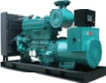

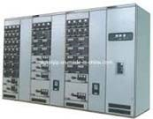
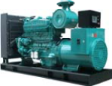


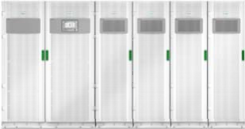
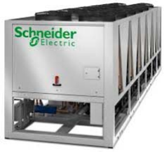
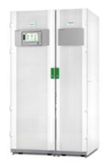
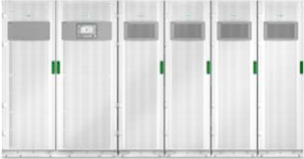

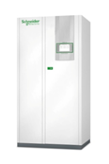


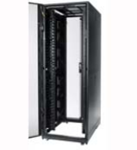
Power Scheme- MSFT (2N UPS & 2N PSUs & CBU)
Feed A
GENSET
Main Switch Board
Feed A
Main Switch Board
Feed B
Feed B
GENSET
DB Feed A
DB Feed B
Isolation
Transformer
Isolation
Transformer
DB
ACMV DB
Aux DB
DB
UPS 9000KVA
Air Cooled Chiller
160KVA UPS (1+1)
UPS 9000KVA
630KW
1260kW (2+1)
DB
DB
Row Cooler
CRAH
Chiller Pump
Modular
PDU
Modular
PDU
Feed B
Feed A
ORW Rack 30 pcs
Notes:
This is a mimic view of the electrical distribution architecture with the purpose of understanding 2N redundant distribution with traditional racks.

Slide 6
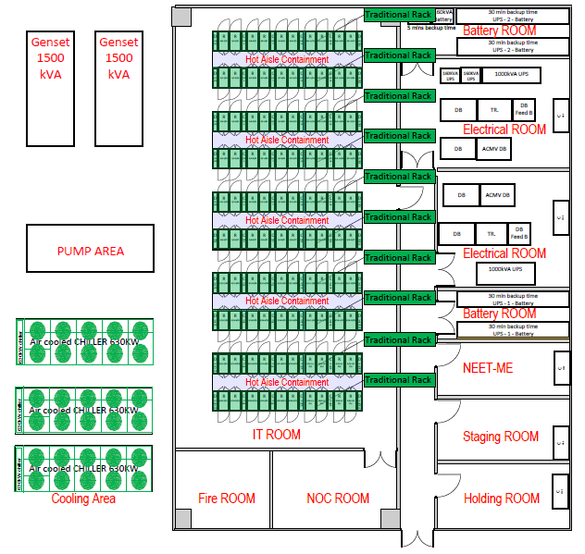
Floor layout- Traditional 2N
Item | Subsystem | Cost (USD) | Remark
1 | Power
2 | Cooling
3 | Rack
4 | IT
5 | Auxiliary
6 | Total

Slide 7
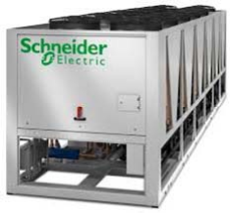



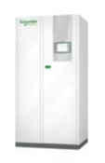


Power Scheme- AMD(N+1 PSU with BBU)
Feed A
GENSET
Main Switch Board
Feed A
Main Switch Board
Feed B
Feed B
GENSET
DB Feed A
DB Feed B
Isolation
Transformer
Isolation
Transformer
DB
ACMV DB
Aux DB
DB
Air Cooled Chiller
160KVA UPS (1+1)
630KW
1260kW (2+1)
Row Cooler
Chiller Pump
CRAH
Modular PDU
Modular PDU
ORW Rack 30 pcs
N+1 PSU
Notes:
This is a mimic view of the electrical distribution architecture with the purpose of understanding 2N redundant distribution with OCP racks with BBU.

Slide 8
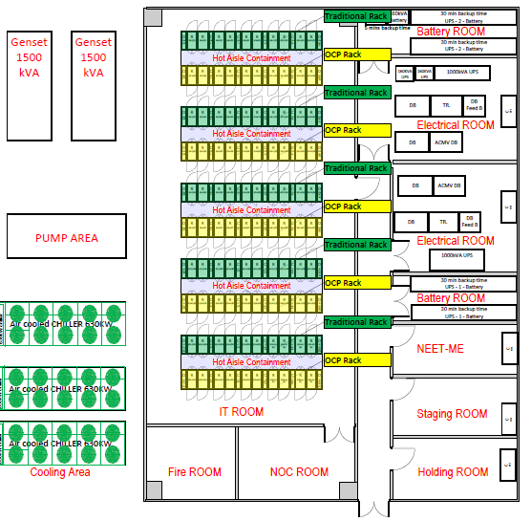
Floor layout- OCP racks without BBU
Item | Subsystem | Cost (USD) | Remark
1 | Power
2 | Cooling
3 | Rack
4 | IT
5 | Auxiliary
6 | Total

Slide 9
Power Scheme- AMD(ATS PSU with LTO BBU)
Feed A
GENSET
Main Switch Board
Feed A
Main Switch Board
Feed B
Feed B
GENSET
DB Feed A
DB Feed B
Isolation
Transformer
Isolation
Transformer
DB
ACMV DB
Aux DB
DB
Air Cooled Chiller
160KVA UPS (1+1)
630KW
1260kW (2+1)
Row Cooler
Chiller Pump
CRAH
Modular PDU
Modular PDU
ORW Rack 30 pcs
ATS N+1 PSU
Notes:
This is a mimic view of the electrical distribution architecture with the purpose of understanding 2N redundant distribution with OCP racks with BBU.

Slide 10
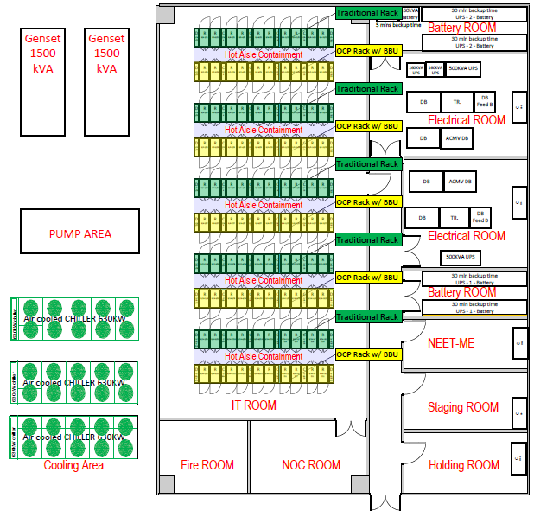
Floor layout- OCP racks with BBU
Item | Subsystem | Cost (USD) | Remark
1 | Power
2 | Cooling
3 | Rack
4 | IT
5 | Auxiliary
6 | Total

Slide 11
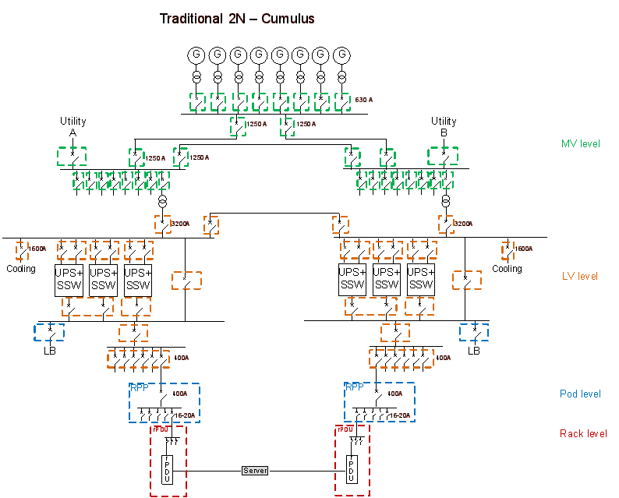
Traditional 2N power architecture today…
Typical 2N design for traditional IT loads
  2N power paths from utility to load, Tier 3
  Adds complexities (“Belts & suspenders”):
    Load bank
    Ties
    Additional UPS output breakers
  Concurrently maintainable
Notes:
Given how data centers are traditionally built (tier 3ish) people will want to know how it compares to their designs..
We know there’s craziness with traditional tier 3 including fully redundant 2N , plus cross ties, load banks for UPS and gen sets testing….

Slide 12
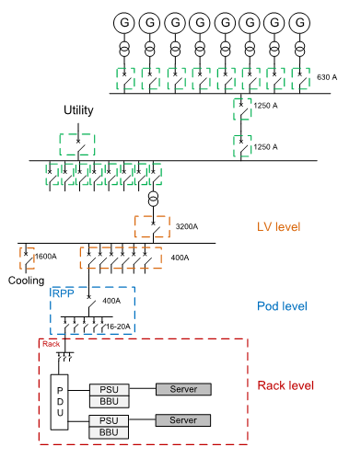
Open Compute Specific 1N architecture
An example of a cost-reduced architecture to support OCP loads
  Aligns with the simplicity and cost-reduction mindset of OCP
  Open Compute servers with one PSU path
  Single path to the IT load
    with rack-based battery backup
    no centralized UPS
  Minimal breaker count
Notes:
10MW example.. This is the design SE developed to align with the simplicity/cost reduction mindset of OCP.
In OCP 1N architecture it is assumed that PSU-s are only N+1 redundant.

Slide 13
Traditional Data Center vs. Open Compute Specific 1N Data Center Capex
1% cost adder for rack system
5% cost adder for Li-ion batteries
12% savings from power supplies
$ / watt
31% savings is from redundancy differences…
8% savings from eliminating upstream UPS…
Traditional 2N
Redundancy
Rack
system
UPS
Batteries
Power supplies
Power supplies
Open Compute Specific 1N
WP228: Analysis of Data Center Architectures Supporting Open Compute Project (OCP) Designs
WP232: Open Compute Project PSUs vs. Traditional PSUs: a Quantitative Analysis
TradeOff Tool 18: Traditional vs. OCP Power Architecture Capex Comparison

Slide 14



Schneider Recommendations (Enterprise Customers):
Open Compute Specific 2N architecture
Compared to traditional 2N, this architecture….
We think most will want to maintain 2N (Tier 3?) redundancy
2N simple design to support OCP IT loads
reduces complexity by eliminating unnecessary cross-ties, additional breakers
saves cost with one battery path, one raw utility path
trusts the redundant server power supplies
“Tiers” in a nutshell
Tier 1: Single power path to IT load; single points of failure
Tier 3: Dual (redundant) power paths to IT load, concurrently maintainable
Notes:
But we know data center managers want a level of redundancy, as we discussed earlier.. But there are smarter ways to design to reduce cost and maintain redundancy.
If we start thinking in terms of “I have to provide power to redundant power supplies all the time” vs. “rely on redundancy of power supplies during maintenance, etc.”, we can eliminate unnecessary components.
In OCP 2 N architecture it is assumed that number of PSU units is fully redundant for ex. N+N vs. N+1.

Slide 15
Cost difference of Traditional 2N vs. Open Compute Specific 2N
$ / watt
Rack, UPS, battery, and PSU differences represent the remaining…
A simplified 2N accounts for more than half of the 25% savings. Architecture simplification includes removing 1 UPS/batteries, ties, breakers, load bank breaker
Traditional 2N
Architecture simplification
Rack
system
UPS
Batteries
Power supplies
Open Compute Specific 2N
Notes:
Architecture simplification includes removing 1 UPS/batteries, ties, breakers, load bank breaker.
Note, rack system is a slight savings in this case instead of a premium. This is because although the rack itself is a premium for OCP, the rPDU savings is bigger since its 2 per rack, resulting in a net savings of .01.
PSU savings is smaller because now we assume 2N OCP PSUs.

Slide 16
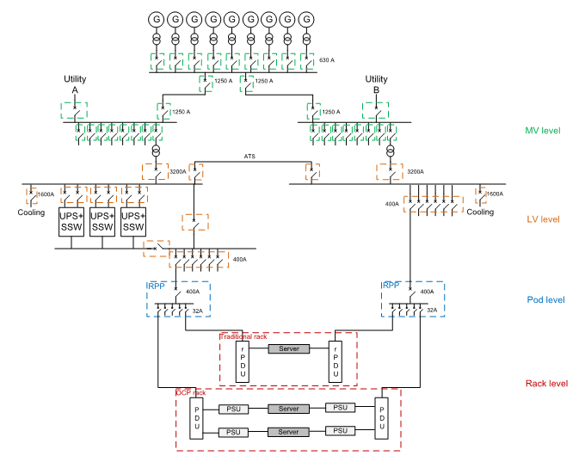
Example of a Simplified 2N design that accommodates both types of loads
Flexible architecture that allows for mix of traditional IT loads and OCP loads
UPS is upstream to support both traditional and OCP loads
To minimize cost, one power path with UPS, one without
OCP loads have dual PSUs without BBUs
Notes:
2 designs SE developed that provide Tier 3ish redundancy levels expected by many data center managers.

Slide 17
A design that accommodates both types of loads
For existing Data Centers using OCP & traditional IT gears
Best fit solution to enterprise customers may comes from the data center status they have.
For the customers are planning to build new DC. Specific 2N may gain both CAPAX & OPAX
For existing DC customers, Simplified 2N would enjoy the benefit also on CAPAX and new IT OCP gears.
$ / watt
For new Data Centers to use OCP

